Slide 1

MACHINE LEARNING-BASED PREDICTIVE ANALYTICS FOR SUPPLY CHAIN OPTIMIZATION

Slide 2
PROBLEM STATEMENT
Modern supply chains face uncertain demand, changing prices, transportation delays, inventory imbalance, and unexpected disruptions.
Traditional planning methods may struggle to capture complex relationships across sales, inventory, pricing, calendar, and operational data.
Therefore, there is a need for a machine learning-based predictive analytics system that can forecast demand and support inventory, logistics, and supply chain decisions.

Slide 3
OBJECTIVES
To integrate data preprocessing, exploratory data analysis, and feature engineering within a single predictive analytics framework.
To compare multiple machine learning models for demand forecasting and supply chain prediction.
To identify important factors such as historical demand, price, seasonality, holidays, and store or product characteristics.
To develop an interactive dashboard for demand forecasts, inventory insights, and supply chain analytics.
To support data-driven decisions that can reduce stockouts, excess inventory, and operational inefficiencies.

Slide 4
LITERATURE SURVEY — PAPERS 1 TO 5
Research Paper | Publication | Key Contribution | Limitations
Review and analysis of artificial intelligence methods for demand forecasting in supply chain management (2022) | Procedia CIRP | Reviews AI methods for demand forecasting and classifies approaches by data characteristics and forecast horizon. | Primarily a review; does not provide a unified deployed optimization system.
The Role of Artificial Intelligence and Machine Learning in Supply Chain Optimization (2023) | Journal of Harbin Engineering University | Synthesizes ML applications in inventory, demand forecasting, logistics, and decision-making. | Broad systematic review with limited implementation detail.
Machine Learning and Deep Learning Models for Demand Forecasting in Supply Chain Management (2024) | Applied System Innovation | Reviews 119 papers and compares ML/DL approaches for supply-chain demand forecasting. | Focuses mainly on forecasting rather than end-to-end optimization.
Enhancing supply chain management with deep learning and machine learning techniques: A review (2024) | Journal of Open Innovation | Reviews ML/DL for supplier selection, production, inventory, transportation, and demand estimation. | Identifies opportunities but does not provide one integrated dashboard.
On the use of machine learning in supply chain management: a systematic review (2025) | IMA Journal of Management Mathematics | Reviews 415 papers and maps ML applications across SCOR processes. | Review-oriented; practical deployment and validation remain open challenges.

Slide 5
LITERATURE SURVEY — PAPERS 6 TO 10
Research Paper | Publication | Key Contribution | Limitations
Machine learning in supply chain management: systematic literature review and future research agenda (2025) | International Journal of Production Research | Reviews 107 studies and highlights demand forecasting, procurement, risk/resilience, and network optimization. | Highlights gaps but does not implement a complete predictive optimization platform.
A systematic review of machine learning approaches in inventory control optimization (2025) | Operations Research Perspectives | Reviews 122 articles and identifies separate, static-integrated, and dynamic/RL approaches. | Scaling and real-world deployment remain challenging.
Leveraging Data Science for Demand Forecasting and Inventory Management (2025) | Journal of Basic and Applied Research International | Discusses predictive analytics, ML, ARIMA, LSTM, and hybrid methods for demand and inventory decisions. | Broad review; data integration and interpretability remain limitations.
Machine Learning Applications in End-To-End Supply Chain Management (2025) | International Journal of Scientific Research and Management | Covers procurement, demand forecasting, production scheduling, inventory, warehousing, and transportation. | Comprehensive review but limited unified experimental validation.
Harnessing machine learning for supply chain management: A systematic review and future research framework (2026) | Computers & Operations Research | Organizes ML research around demand forecasting, procurement, risk/resilience, and network optimization. | Identifies technical, organizational, and contextual barriers that require further validation.

Slide 6
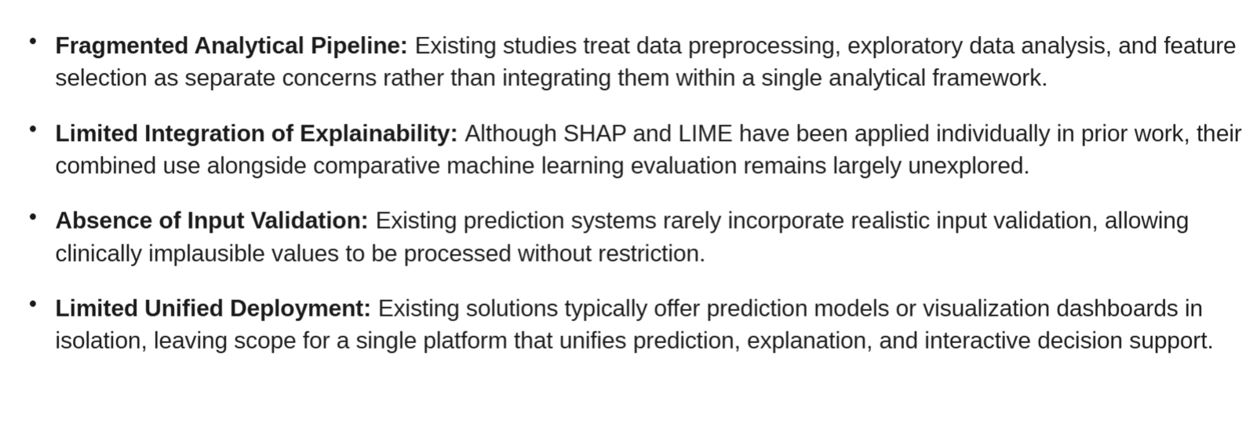
RESEARCH GAP
Existing research has extensively applied machine learning to demand forecasting, inventory management, transportation, procurement, and supply chain risk.
Many studies focus on a single supply chain function or a single forecasting objective.
Recent reviews show growing use of supervised learning, deep learning, and reinforcement learning, but practical integration across forecasting, inventory insights, and logistics analytics remains challenging.
Therefore, the proposed work focuses on connecting predictive forecasting, feature-based analysis, model comparison, and an interactive decision-support dashboard in one framework.

Slide 7
DATASET
M5 WALMART SALES FORECASTING DATASET OVERVIEW
Source & Scale
30,490 bottom-level product–store time series
3,049 products across 10 stores
Three U.S. states: California, Texas, Wisconsin
Daily historical sales spanning about 5.4 years
Publicly available M5 Forecasting dataset
Operational Data
Daily unit sales
Product, department and category
Store and state
Weekly selling price
Calendar, holidays, events and SNAP indicators
Target: future product demand / sales forecast
Key Predictors
Historical demand and lag values
Rolling averages and trends
Price and price changes
Weekday, month and seasonality
Special events and holidays
Store, state, category and department
Forecast horizon: 28 days

Slide 8
PROPOSED METHODOLOGY
ML Pipeline:
Dataset → Data Cleaning → Exploratory Data Analysis → Feature Engineering → Train/Test Split → Machine Learning Models → Demand Forecasting → Model Evaluation → Inventory & Supply Chain Insights → Interactive Dashboard
Models:
Linear Regression, Random Forest, XGBoost/Gradient Boosting, and time-series/deep-learning models where appropriate.
Evaluation Metrics:
MAE, RMSE, MAPE/WAPE and forecast accuracy measures; business-oriented analysis of stockout and excess-inventory risk.

Slide 9
DEVELOPED DASHBOARD
Product/store-level demand prediction
28-day demand forecast visualization
Historical sales and trend analysis
Price, calendar and event-based insights
Inventory risk indicators for high/low demand
Store, category and department filters
Model performance and feature-importance insights

Slide 10
KEY INNOVATIONS
Interactive Predictive Dashboard
User-driven exploration of demand forecasts and supply-chain indicators
Multi-Level Supply Chain Analysis
Analysis across products, departments, categories, stores and states
Unified ML + Visual Analytics Platform
Integration of data preprocessing, forecasting, model comparison, and interactive visualization
Decision-Support Insights
Translates predicted demand into practical inventory and replenishment insights, helping identify potential stockout and overstock situations.

Slide 11
RESEARCH CONTRIBUTION & FEASIBILITY
Contributions
Integration of demand forecasting and supply-chain analytics in one framework
Comparison of multiple ML approaches using common evaluation metrics
Feature-based analysis of demand drivers such as price, seasonality, events, and store/product attributes
Interactive dashboard for practical decision support
Technical Feasibility
Built with Python and open-source libraries such as Pandas, NumPy, Scikit-learn, XGBoost, Plotly and Streamlit
Uses the publicly available M5 Walmart dataset
No specialized hardware is required for a prototype
Browser-based dashboard can support academic and demonstration use
Implementation Scope
Forecasting can be trained at selected product/store levels or aggregated levels to manage computational requirements.
The system is designed as a research prototype and can later be connected to live enterprise supply-chain data.

Slide 12
CONCLUSION & FUTURE SCOPE
Conclusion:
The proposed system combines machine learning, predictive analytics, demand forecasting, and interactive visualization to support supply chain optimization. It aims to turn historical sales and operational data into actionable forecasts and inventory insights.
Future Scope:
Integration of real-time sales, inventory, and logistics data
Probabilistic forecasting and uncertainty estimation
Reinforcement learning for dynamic inventory optimization
Supply-chain disruption and risk prediction
Multi-echelon inventory optimization
Deployment with cloud and enterprise ERP/SCM systems
Explainable AI for transparent business decisions
Note: This system is a research and decision-support prototype. Forecasts should be validated against business constraints, operational policies, and real-world supply-chain conditions before production use.

Slide 13
THANK YOU

